Slide 1
Classification of Cardiomegaly Using X-ray Images and Segmentation of Hippocampus Using MRI Scans
Chinmay Mokashi
Samia Islam
Sarita Soebianto
Group G1
BMI 6331 Medical Imaging and Signal Pattern Recognition
9 December, 2022
Rev. 11/29/22
Notes:
Describe yourself and your research question to the class. Get your audience’s attention -- why are you interested in this, and why should they be? However, don’t use up a lot of time here (limit this to about 30 seconds), otherwise, you will likely run over time when you are discussing the papers.
Credentials are your earned degrees (BS, BA, MD, etc.)
For degree track: here are some suggestions:
Certificate
MS Research track / Bioinformatics
PhD
Rice University / Keck Fellow

Slide 2

Objectives
Image classification
Identify patients with cardiomegaly using X-ray images
Image segmentation
Identify anterior and posterior areas of hippocampus using 3D T1 MRI scans

Slide 3
Task 1 outline
Background
Method
Results and conclusion

Slide 4
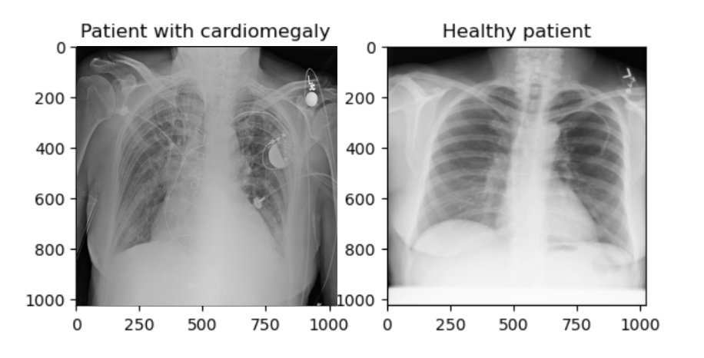
Background
What is cardiomegaly?
condition of an enlarged heart
visible on medical imaging test, like X-ray
occurs in diseases and conditions, like high blood pressure and coronary artery disease
(Lee et al., 2021)

Slide 5
Data
About the dataset
Part of the NIH-maintained chest X-ray repository
21,966 labeled images
767 cardiomegaly patients, 21,199 healthy patients
Testing set included 300 healthy and 300 cardiomegaly patients

Slide 6
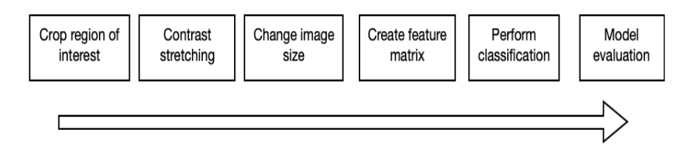
Method
Model pipeline

Slide 7
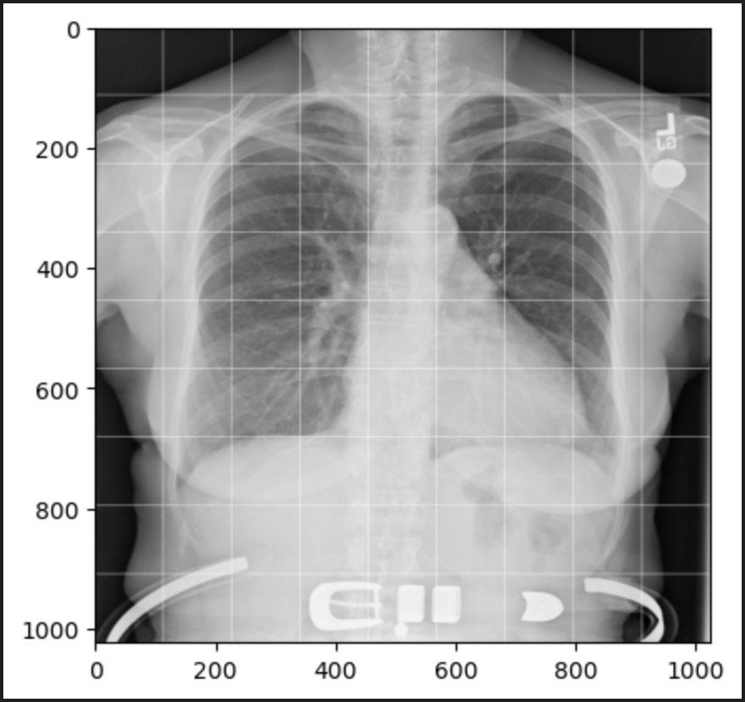
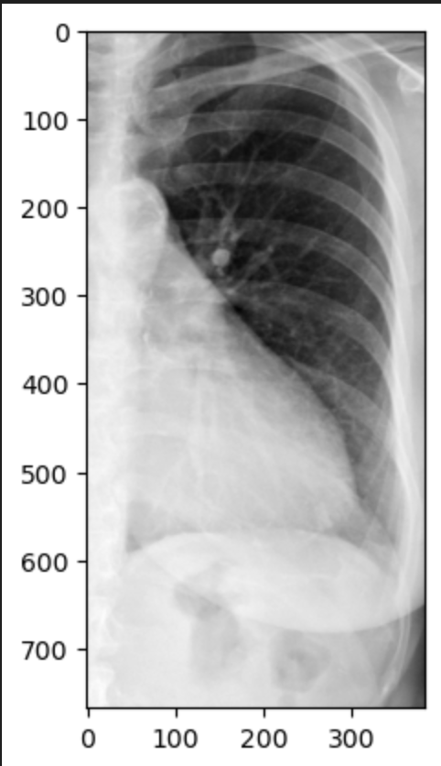
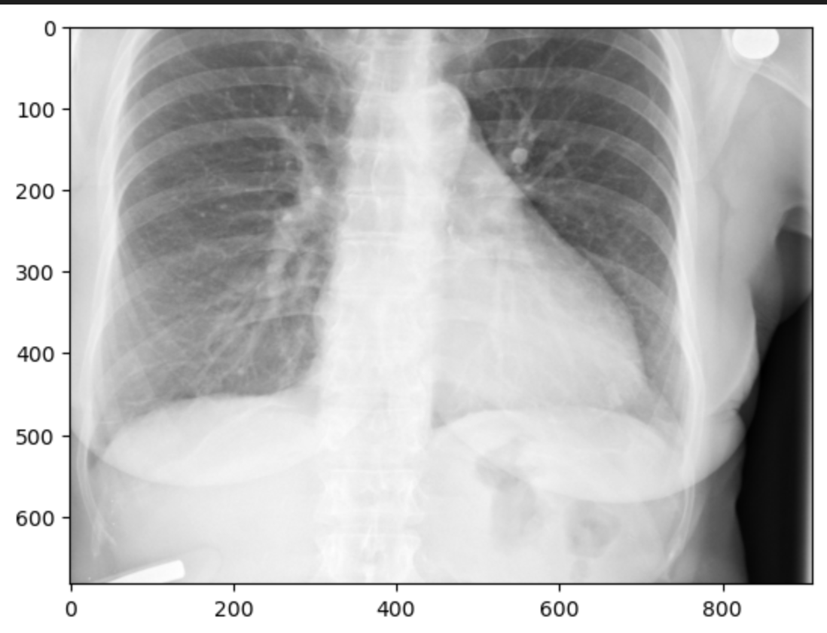
Cropping of region of interest
1. divide into 8x8 grid
2. pick between (1,7) and (4,7)
1. divide into 9x9 grid
2. pick between (2,8) and (1,9)
Modified cropping of region of interest based on Zhou et al., 2019

Slide 8
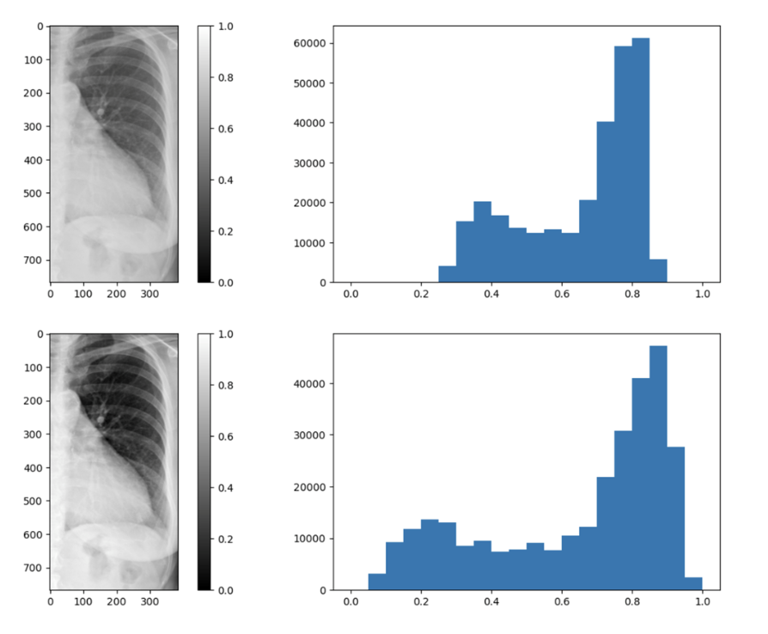
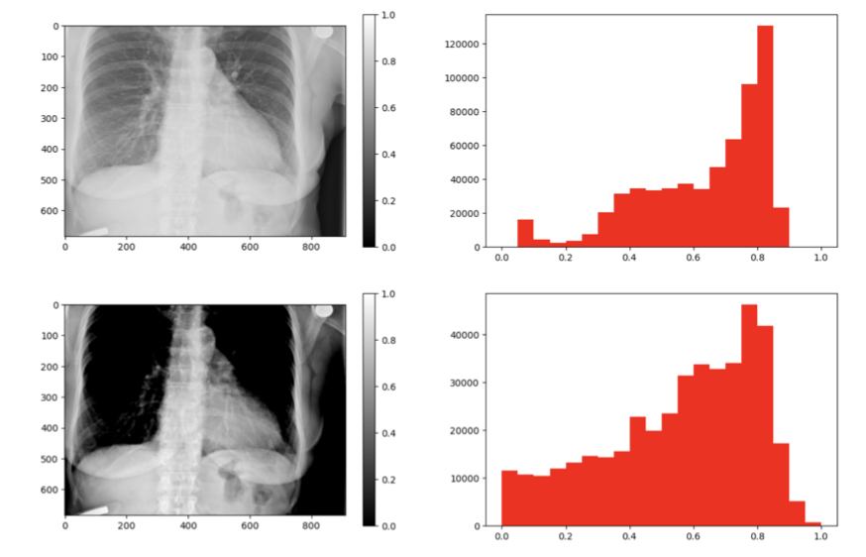
Contrast stretching
Before and after contrast stretching on left chest region
Before and after contrast stretching on larger chest region

Slide 9
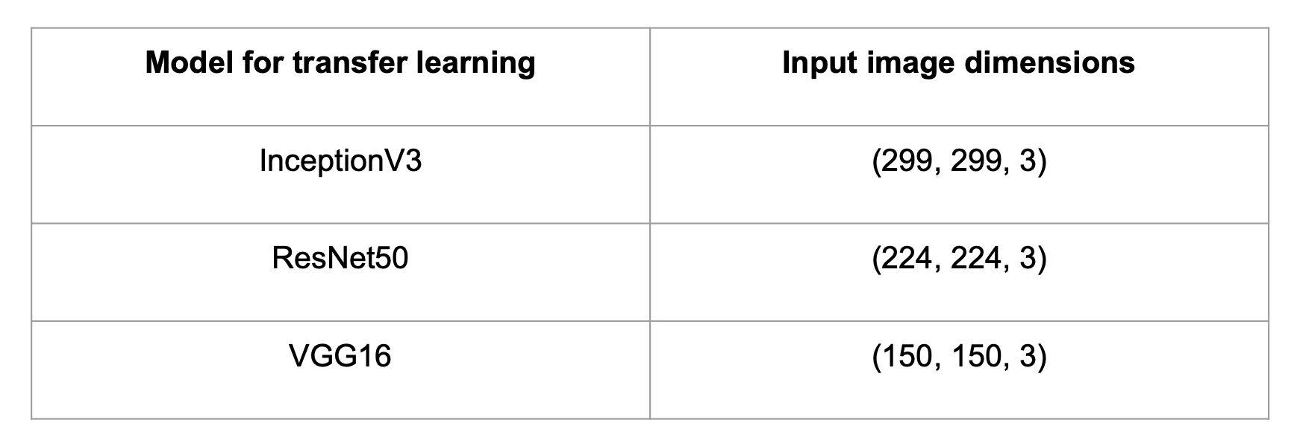
Image size adjustment
Images converted to satisfy requirements of transfer learning methods

Slide 10
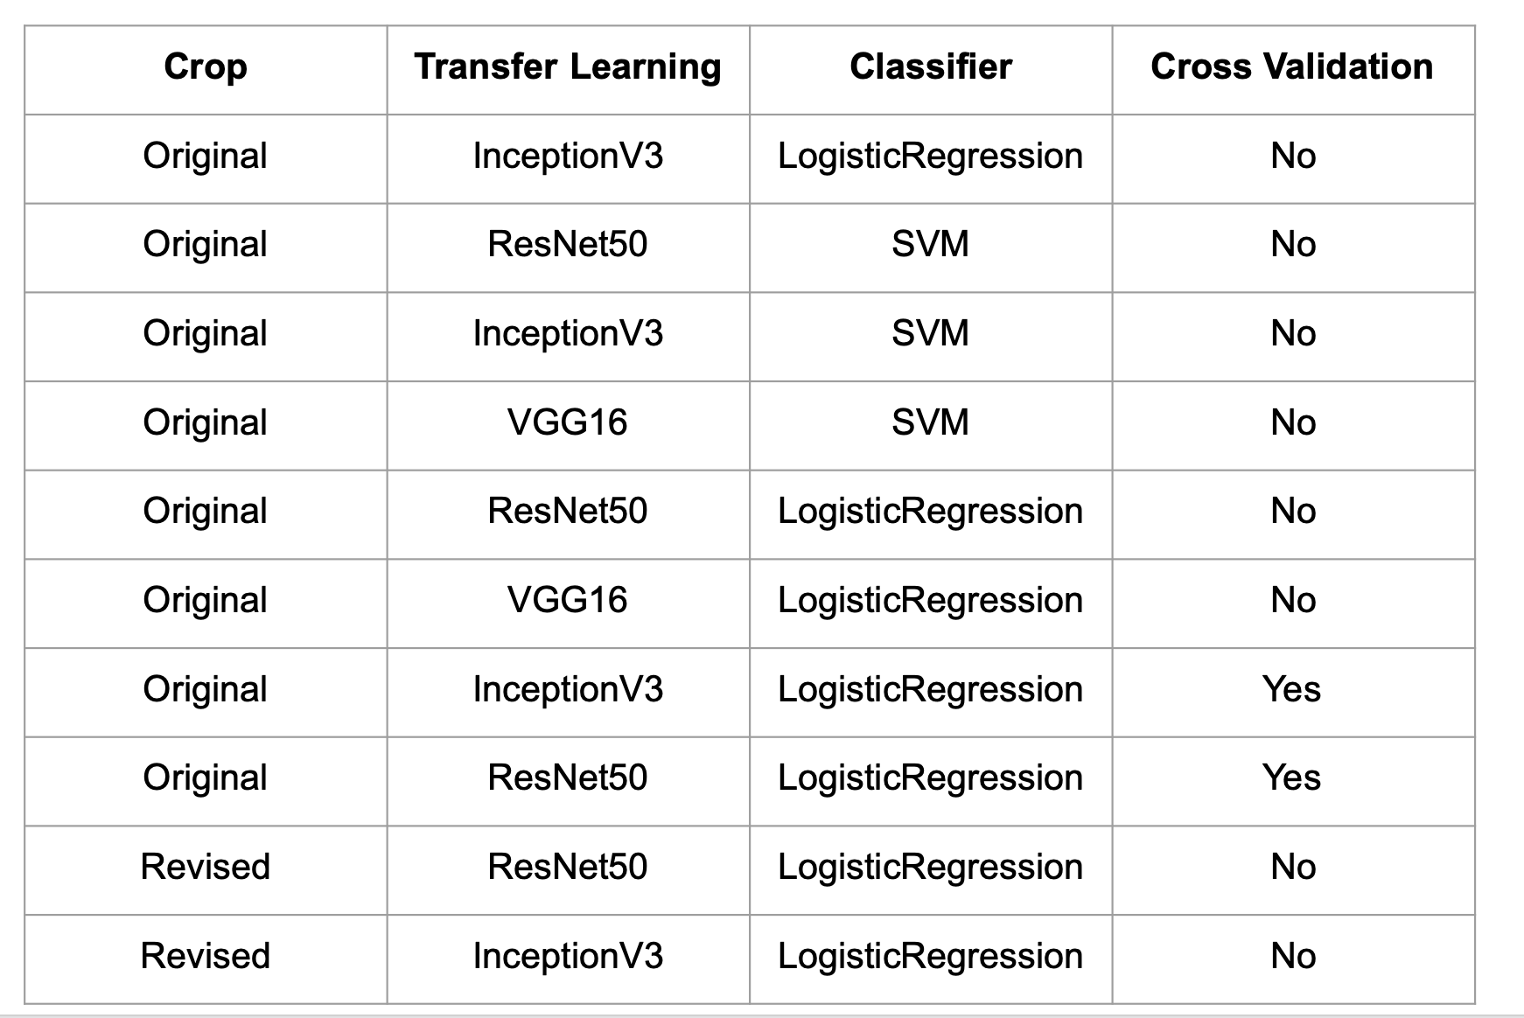
Algorithms

Slide 11
Cross validation
Training data highly imbalanced
Number of healthy: 20899
Number with cardiomegaly: 467
Different folds were created
50:50 split between healthy and cardiomegaly
Cardiomegaly samples re-used
Healthy samples used without replacement

Slide 12
Model evaluation
ROC curves
AUC
F1 scores

Slide 13
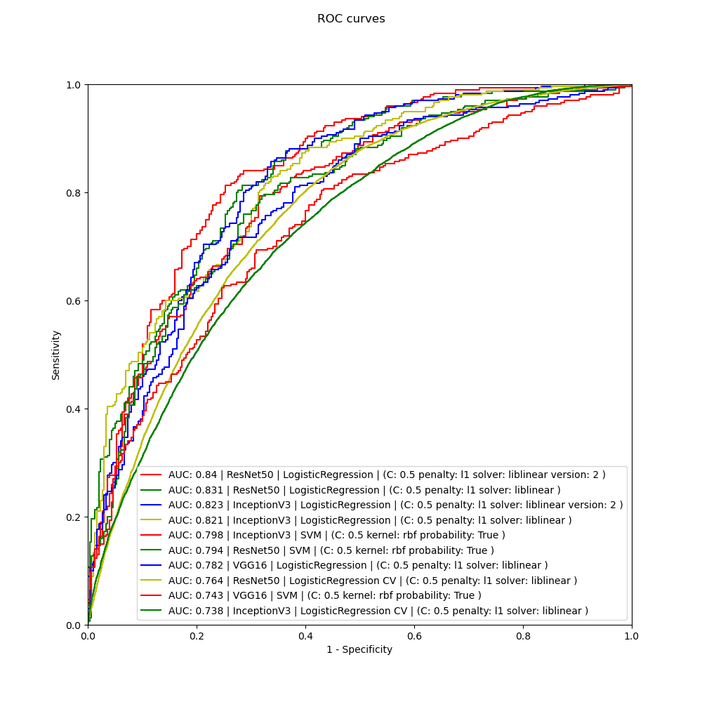
Performance of models

Slide 14
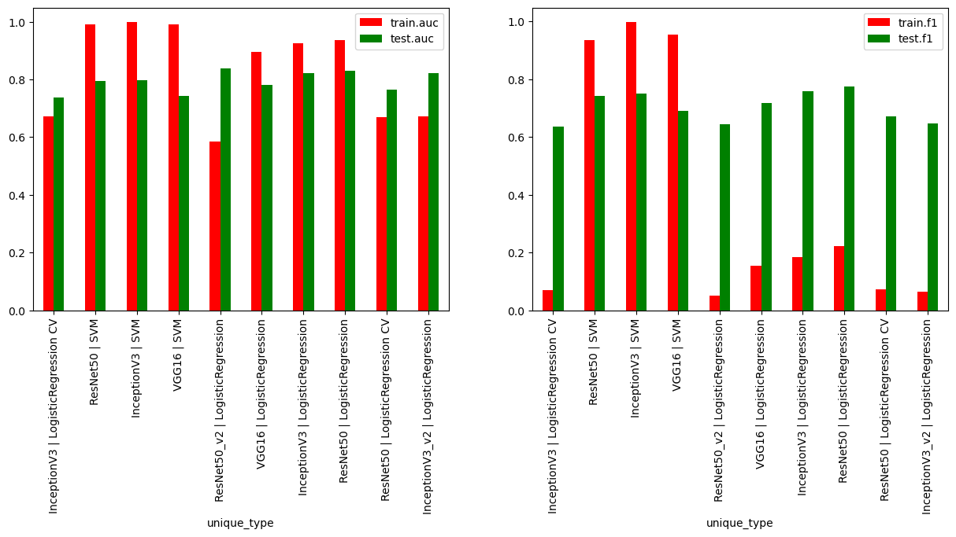
Train vs test performance

Slide 15
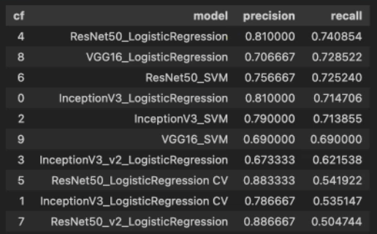
Model precision and recall

Slide 16
Future areas of interest
Compare F-1 scores amongst classes - age, gender, X-ray view positions
Understand why pipelines with larger cropped region showed low recall

Slide 17
Task 2 outline
Background
Method
Results
Conclusion

Slide 18
Background
Hippocampus - a region of the brain considered as the center of a brain network supporting encoding, consolidation, and retrieval of memory (Bartsch, 2012)
In diagnosis and disease management, morphological analysis of the hippocampus is important (Bartsch et al., 2015)
Gray levels of the hippocampus in MRI are very similar to other neighboring structures, making automatic segmentation challenging (Fischl et al., 2002)

Slide 19
Data
About the dataset
Acquired at the Vanderbilt University Medical Center, Nashville, US.
MRI images of healthy adults and adults with a non-affective psychotic disorder. T1-weighted MPRAGE was used as the imaging sequence.
The target ROIs: the anterior and posterior of the hippocampus.

Slide 20
Method
nnU-Net used to create image segmentation pipeline
Designed to deal with the dataset diversity found in the biomedical domain
Condenses and automates the keys decisions for designing a successful segmentation pipeline for any given dataset
Dataset was converted to nnU-Net compatible dataset
3D full resolution UNet was trained (5 fold)

Slide 21
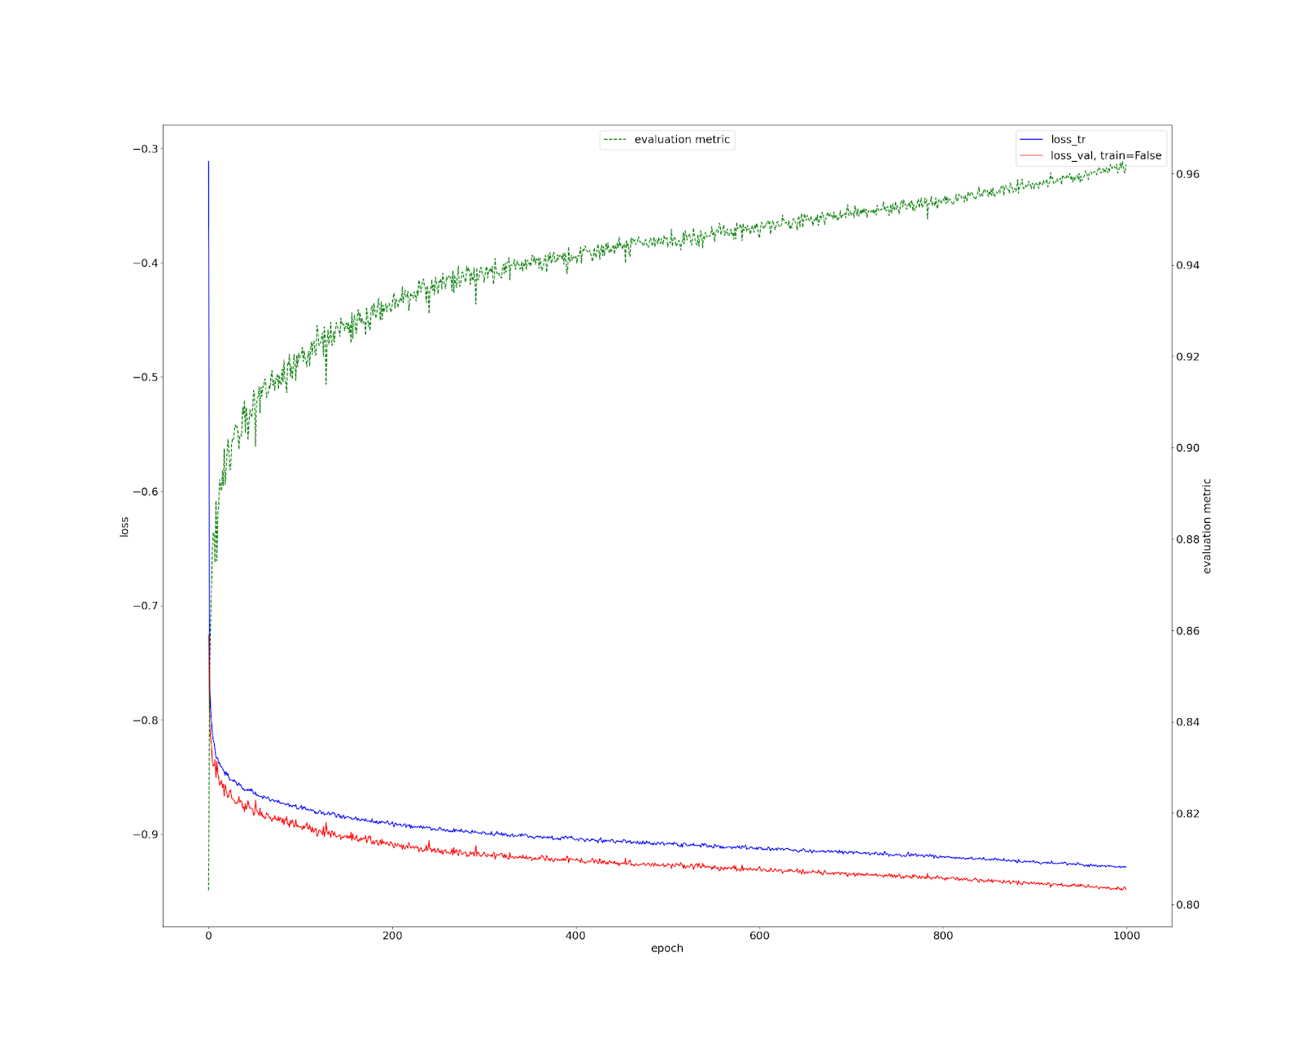
Results

Slide 22
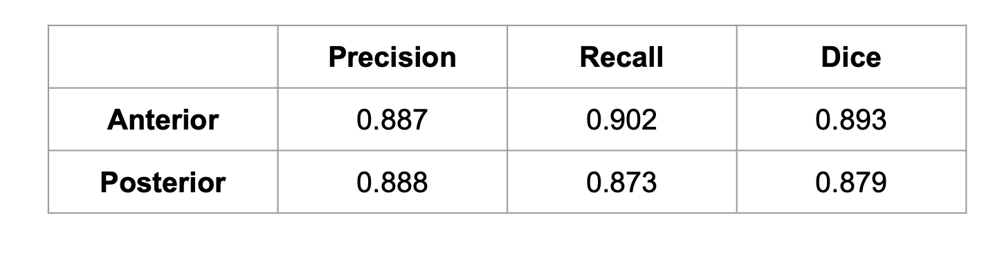
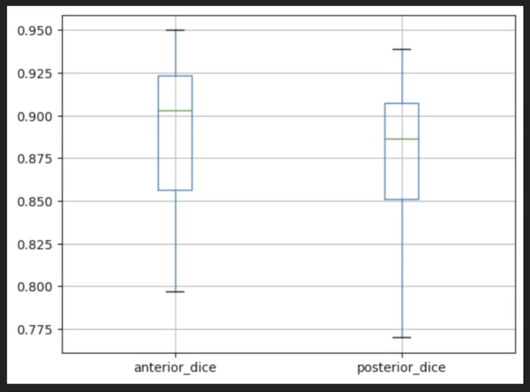
Results
Average of all Dice scores across MRI volumes

Slide 23
Conclusion
Automatic segmentation of the hippocampus in MRI is challenging (Fischl et al., 2002)
nnUNet is an attractive choice because of ease of use (Pettit et al., 2022)
Model performed with dice scores of 0.879 and 893 for posterior and anterior, respectively

Slide 24
References
M. S. Lee, Y. S. Kim, M. Kim, M. Usman, S. S. Byon, S. H. Kim, B. I. Lee, and B. D. Lee, “Evaluation of the feasibility of explainable computer-aided detection of cardiomegaly on chest radiographs using deep learning,” Scientific Reports, vol. 11, no. 1, pp. 16885, 2021, doi: 10.1038/s41598-021-96433-1.
S. Zhou, X. Zhang, R. Zhang, “Identifying cardiomegaly in ChestX- ray8 using transfer learning,” Stud Health Technol Inform, vol. 264, pp. 482-486, Aug 2019, doi: 10.3233/SHTI190268.
T. Bartsch, The Clinical Neurobiology of the Hippocampus. Oxford, UK: Oxford University Press, 2012.
T. Bartsch, and P. Wulff, “The hippocampus in aging and disease: From plasticity to vulnerability,” Neuroscience, vol. 309, pp. 1–16, 2015, doi: 10.1016/j.neuroscience.2015.07.084.
R. W. Pettit, B. B. Marlatt, S. J. Corr, J. Havelka, A. Rana, “nnU-Net deep learning method for segmenting parenchyma and determining liver volume from computed tomography images,” Annals of Surgery Open, vol. 3, no. 2, pp. e155, Jun. 2022, doi: 10.1097/AS9.0000000000000155.
B. Fischl, D. H. Salat, E. Busa, M. Albert, M. Dieterich, C. Haselgrove, A. van der Kouwe, R. Killiany, D. Kennedy, S. Klaveness, A. Montillo, N. Makris, B. Rosen, and A. M. Dale, “Whole brain segmentation: automated labeling of neuroanatomical structures in the human brain,” Neuron, vol. 3, pp. 341–355, 2002, doi: 10.1016/s0896-6273(02)00569-x.

